Slide 1
Project 2 – Data Visualisation
December
2021
The Animal Inhabitants of
US National Parks

Slide 2
Planning a trip to observe animals in their natural habitat?
Use these customisable maps to find what animals
can be found in which National Parks.

Slide 3
Mission Statement
To create an easily usable app that will enable the user to explore what animals can be found in a selection of National Parks in the USA
The app will have multiple visualisations that will allow the user to explore the following
what animals are in each park;
or search by animal to find which parks it can be found in;

Slide 4
Technical Talk
The process we followed to complete the project
Obtaining and Storing Data
Creating the app
Web scraping was used to create a .csv file of animals found in each park, while park locations were accessed via an available .csv file
From these, and sqlite database was created to house the data
HTML, JS, flask

Slide 5
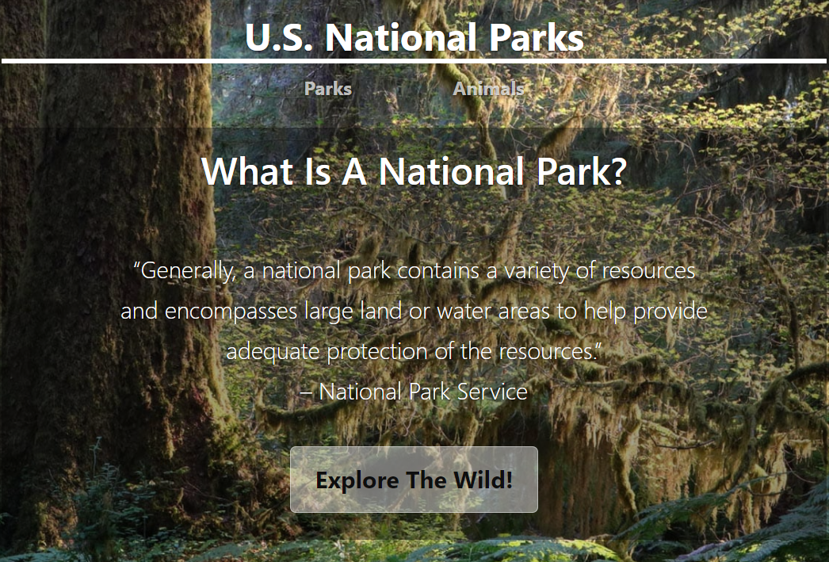
Landing Page
From the home page, you can navigate to either the parks map or the animals map.
The “Explore the Wild” button will also navigate to the Parks page.

Slide 6
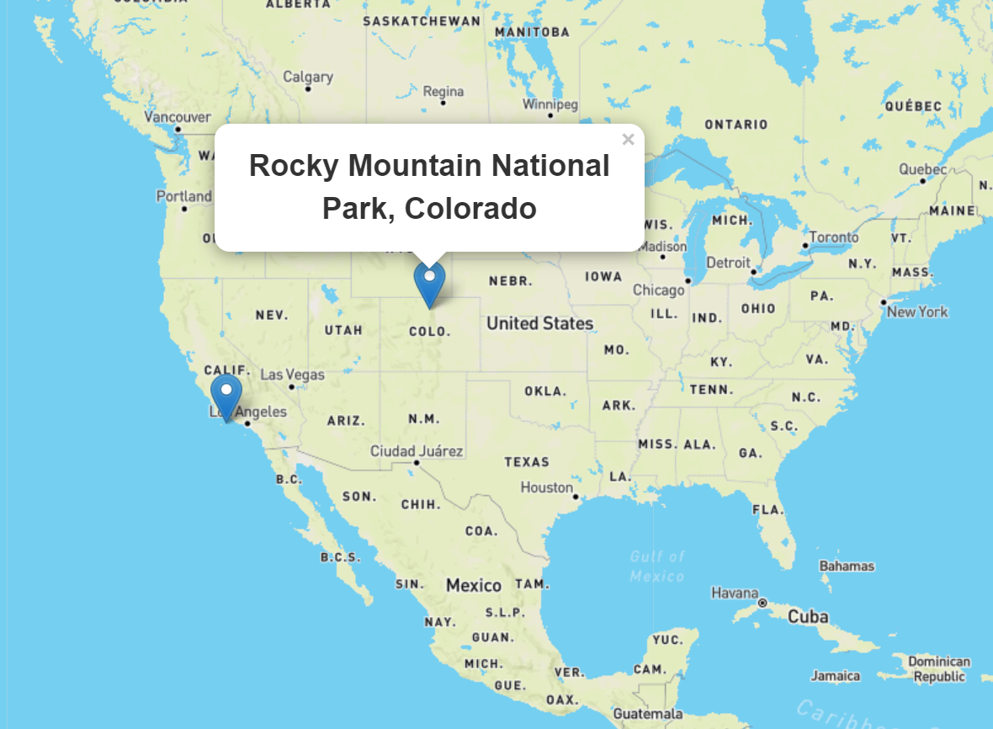
Map Page 1
The “Parks” page marks a number of the US national parks that we have animal location data for.

Slide 7
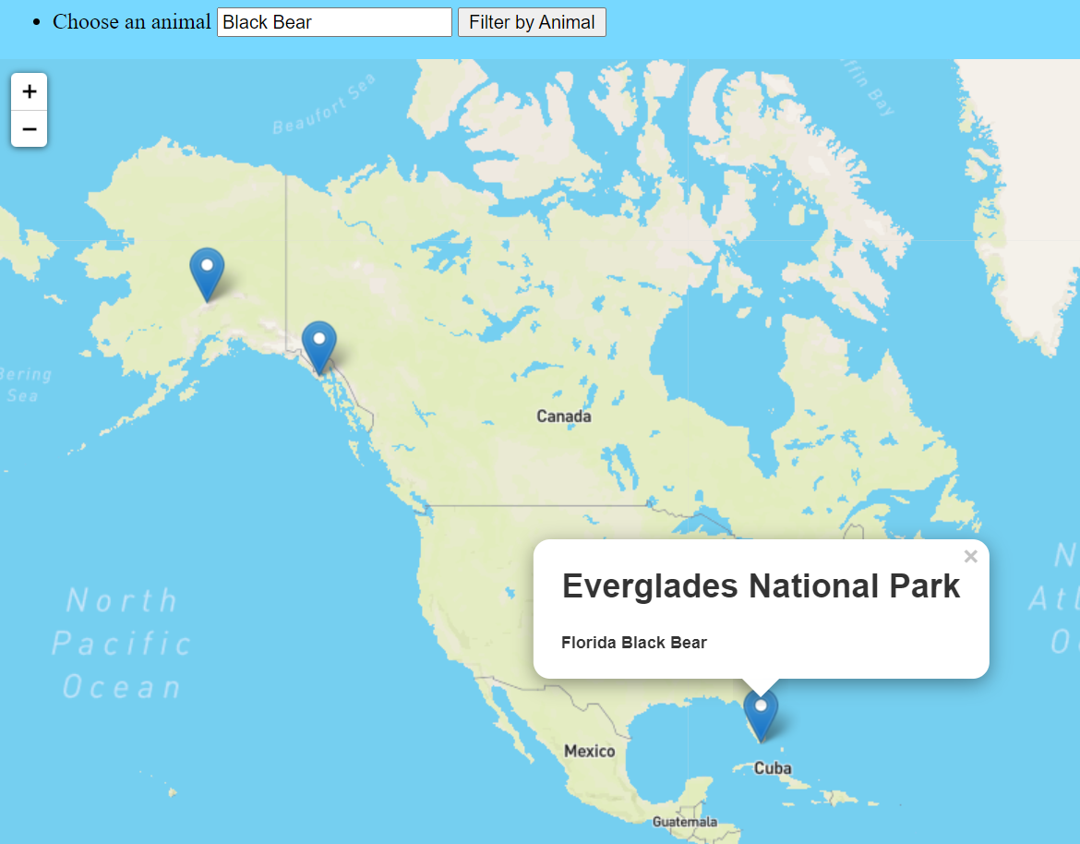
Map Page 2
The “Animals” page allows you to search by animal type. Search results will pront markers on the map showing which parks this animal can be found in.

Slide 8
Data and Map Sources
https://irma.nps.gov/NPSpecies/Search/SpeciesList/ACAD
https://www.latlong.net/category/national-parks-236-42.html
https://www.mapbox.com/about/maps/
https://openweathermap.org/api/statistics-api#geo-month

